Slide 1
CSC 1119: CS is Problem Solving
Summer 2021: Introduction to Programming: C++
© 2018
Colorado State University
Computer Science Department
Slides Originally Created by Albert Lionelle (Albert.Lionelle@colostate.edu)

Slide 2
Welcome Students!
The following slides
Pulled from CSU’s CS 150 - our Introduction to Programming for Non-Majors
Focusing on the History of CS, and what is CS in general.

Slide 3
Fox, Hen, Grain
A farmer has a fox, hen and a bag of grain. She needs to cross the river in a rowboat, but can only take one thing at a time. Unfortunately, the fox will eat the hen, and the hen will eat the grain - and so she can’t leave them alone with each other.
In pairs, try to figure out how she can get all three across the river safely!

Slide 4
Solution?
Step 1: Farmer takes the Hen on over
Step 2: Farmer goes back for the fox, and takes on over
Step 3: Farmer takes the hen on back
Step 4: Farmer takes the grain on over
Step 5: Farmer goes back for the hen, and takes the hen on over.

Slide 5
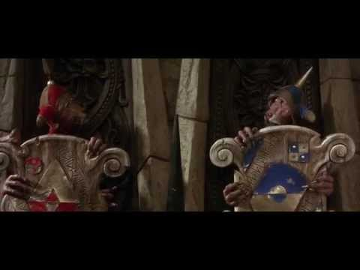
Peer Instruction Challenge
No Programming Required
Work with person next to you
Write down a solution / agree on a solution.
Can you explain how you go there in steps?
Remember: One guard always tells the truth, one always lies - what is the one question to can ask one guard to find the right path.

Slide 6
Solution
Reality: Programmers don’t start out thinking like this. A computer science degree helps train you to think like this.
Assume A lies but leads to life, and B tells the true but leads to death. The answers are Life and Death
Ask A does it lead to life? Answer is No (false)
Ask B does it lead to life? Answer is No (false)
No definitive answer
Ask A does it lead to death? Answer is Yes (true)
Ask B does it lead to death? Answer is Yes (true)
No definitive answer
Ask A does B lead to death? Answer is no (false)
Ask B does A lead to death? The answer is no (false)
(same combination for life)
No definitive answer
Ask A what would B thinks A would say about leading to life? Answer is no (false)
Ask B what A thinks B would say about leading to life? Answer is yes (true)
Unique Answer!
Don’t stop there! Check solution, when you check it, you find you need to reverse it

Slide 7
Computer Science is….
Solving real world problems using technology as our means to solve them.
Corollary: Computer Sciences seek to improve the world around them by attempting to solve some of the worlds unsolvable problems.

Slide 8

What does this have to do with programming?
Divide
Programming == Problem Solving
You look at the problem to solve
Clarify the problem and constraints
Break it up into *smaller* parts (Divide)
Outline the steps needed
Solve each step (Conquer)
Reassemble the pieces (Glue)
Completed program
In fact - Most Programming
Started on a piece of paper
By mathematicians
Conquer
Conquer
Conquer
Glue

Slide 9
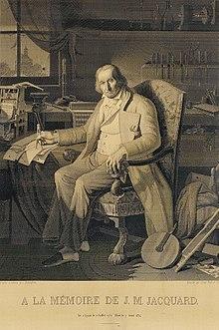
First Computer?
The industry - Weaving!
Jacquard loom / machine
Invented by Joseph Marie Jacquard in 1804
Cards set the patterns, colors, etc
Very specific use - not general purpose
“This portrait of Jacquard was woven in silk on a Jacquard loom and required 24,000 punched cards to create (1839). “ - ref: https://en.wikipedia.org/wiki/Jacquard_loom

Slide 10
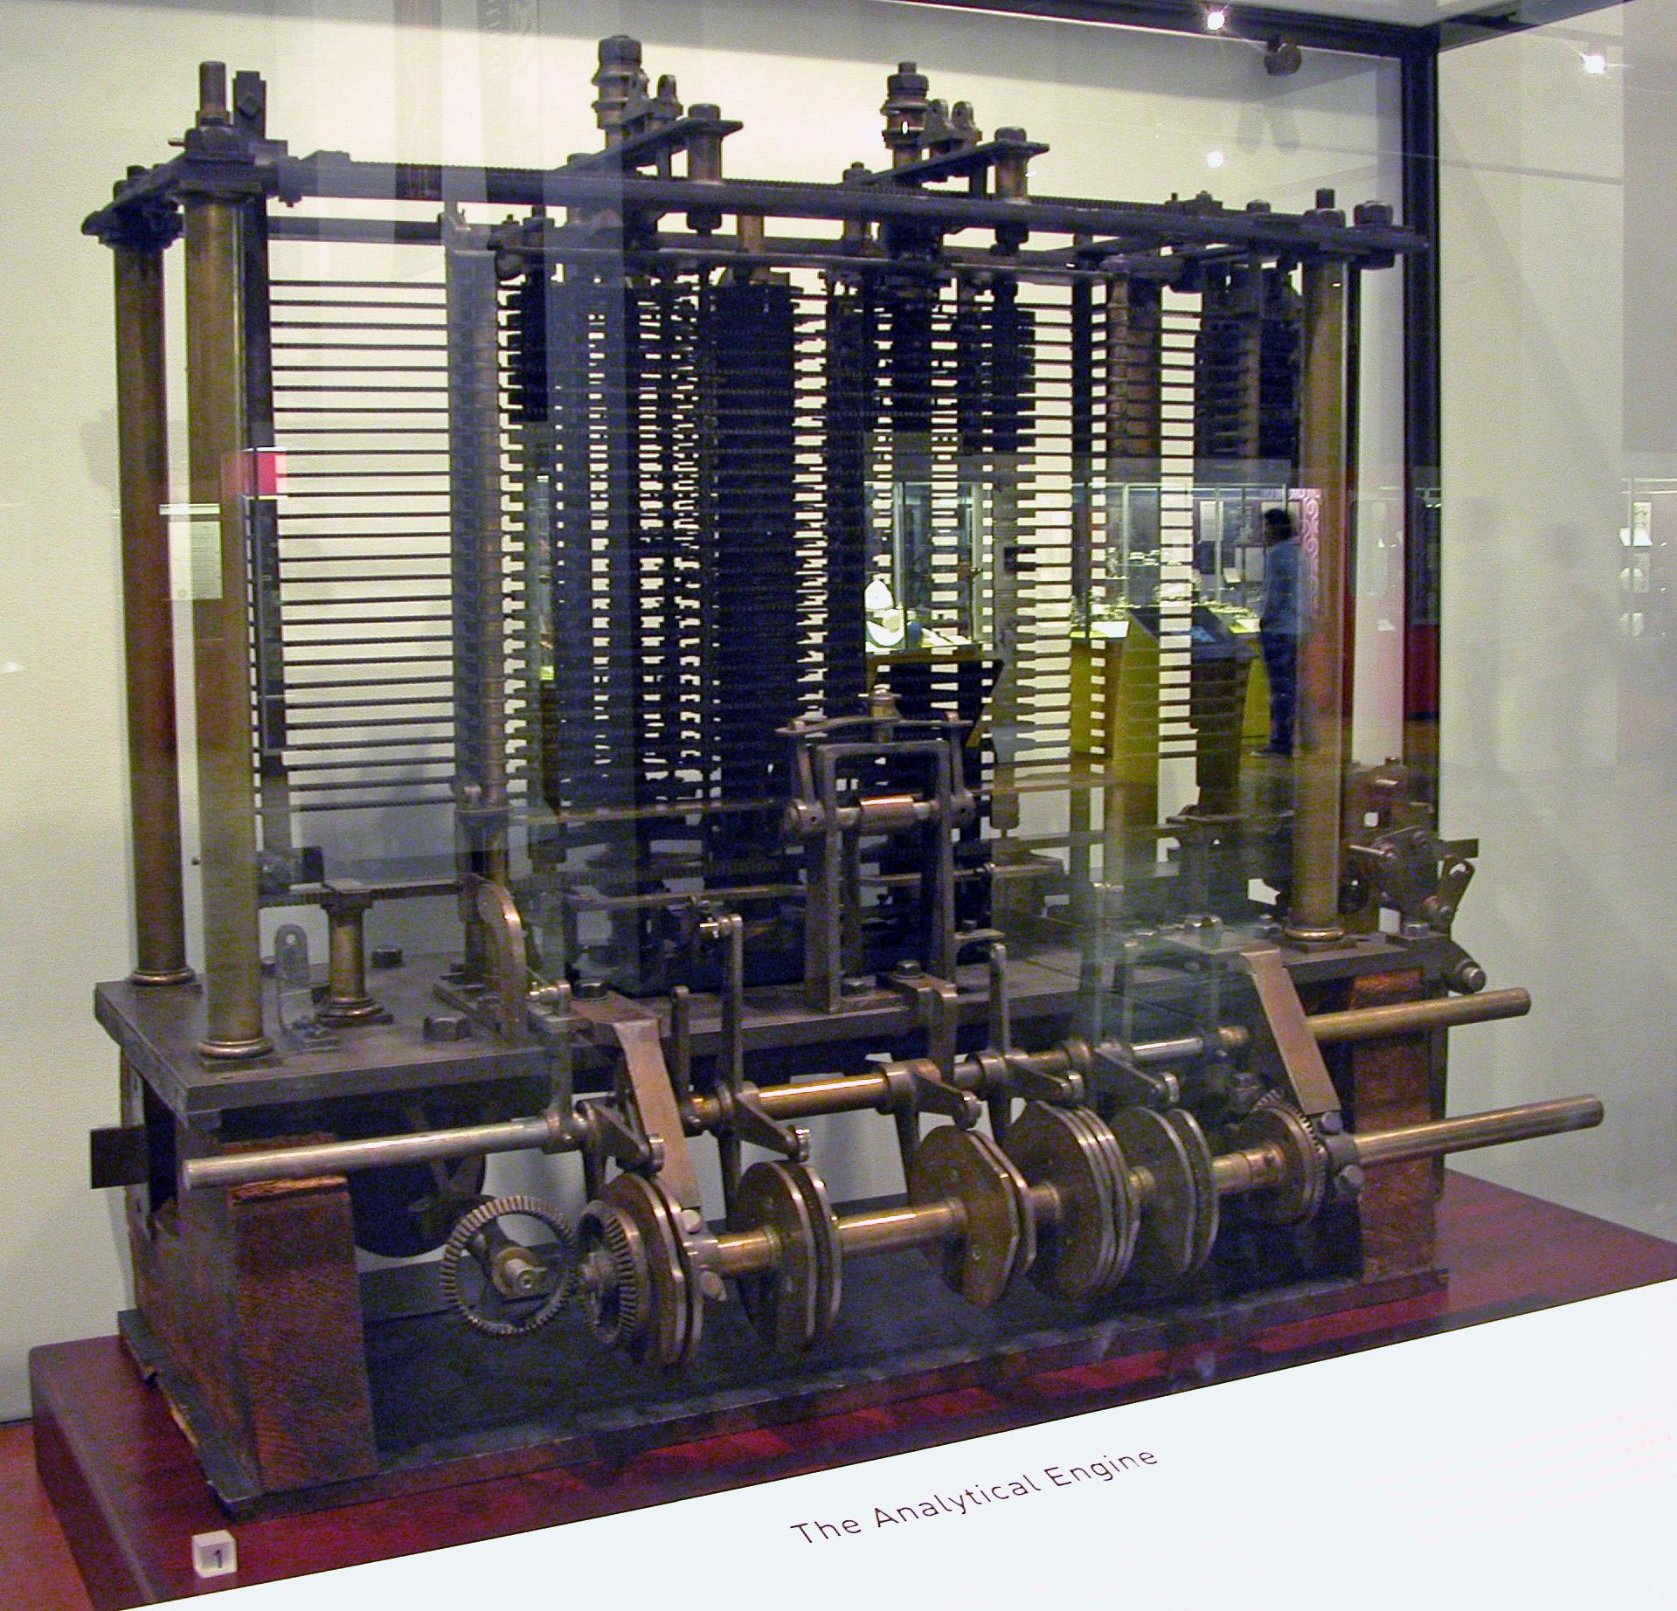
Analytical Engine
Charles Babbage
Polymath
“Father of the computer”
Mainly Theory
Purpose?
Algorithm Development and solving
1837
Bruno Barral (ByB) [CC BY-SA 2.5 (https://creativecommons.org/licenses/by-sa/2.5)], from Wikimedia Commons

Slide 11
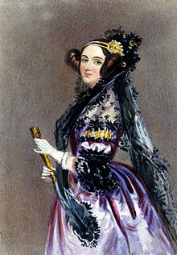
Enchantress of Numbers
She walks in beauty, like the night
Of cloudless climes and starry skies;
And all that’s best of dark and bright
Meet in her aspect and her eyes;
Thus mellowed to that tender light
Which heaven to gaudy day denies.
Excerpt from “She Walks in Beauty” by Lord Byron

Slide 12
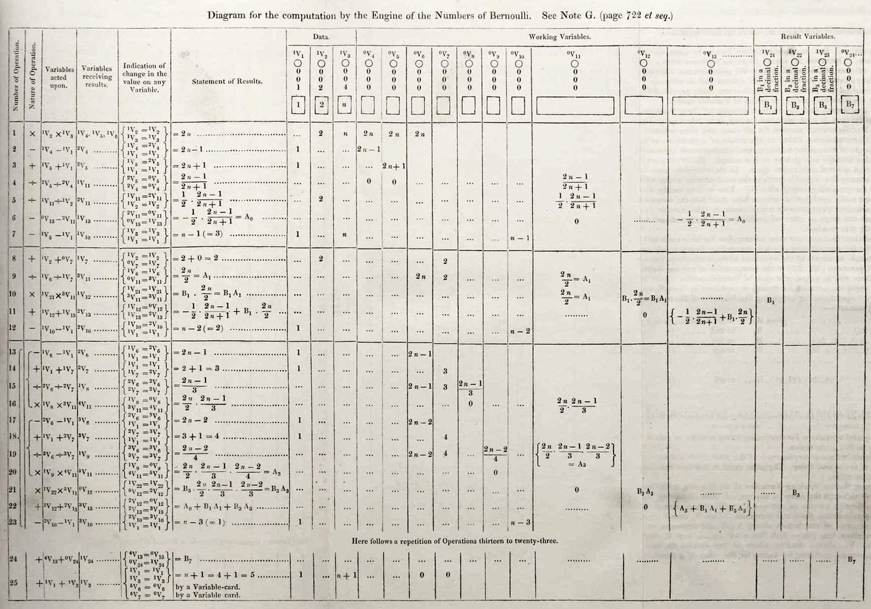
Ada Lovelace
Grew up in a rich but a single mother household
Father was the famous poet Lord Byron
Was known as a rebellious child and adult (non-conformist)
Mother insisted on her becoming a mathematician
She was unruly:
part artist
part scientist
part philosopher
Wrote the first “Computer Program”
Theorized computers could be ‘general purpose’ machines to solve complex problems.
By Ada Lovelace (http://www.sophiararebooks.com/pictures/3544a.jpg) [Public domain], via Wikimedia Commons

Slide 13
"I propose to consider the question, 'Can machines think?'"
Alan Turing - Computing and Intelligence, 1950.

Slide 14
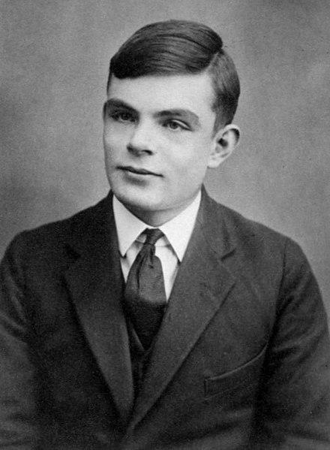
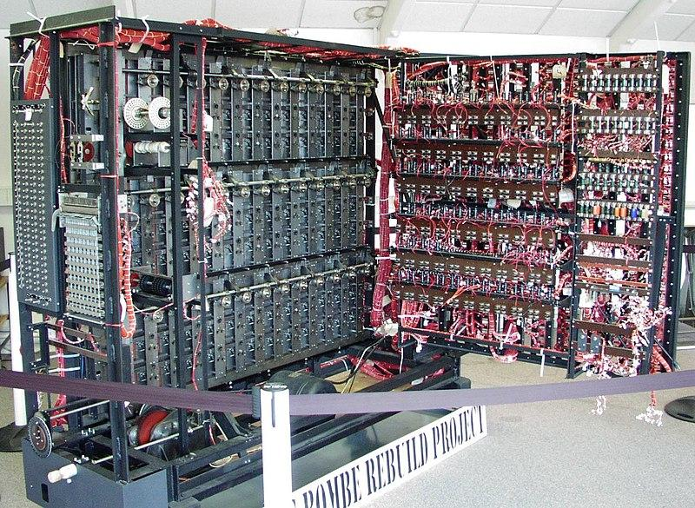

Alan Turing
Mathematician and Philosopher
Enigma Code Breaker - Bombe Machine
Series of interlocking wheels
Looked at all combinations
Website “Additional Readings” WWII Hero has a great interactive example
Turing Machine
Analog theoretical computer
We have ‘close approximations’
Turing Test
Imitation Game
Thinking is hard to define
Later life
Chemical Castration (DES)
Died age 41 from Cyanide poisoning
Queen pardoned him of ‘crimes’ - 2013
See page for author [Public domain], via Wikimedia Commons
Replica of Bombe Machine
Photographer: Tom Yates. Source

Slide 15
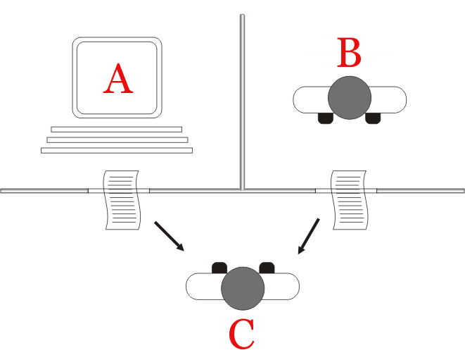
Turing Test - Philosophical A.I. Debate
Imitation Game
Easier than determining thinking
Does not determine intelligence
Thinking of modern computing
What is a good way to do this test?
Hint: look at your phones
CHAT BOTS!
Jabberwacky being a prize winner.
By Juan Alberto Sánchez Margallo [CC BY 2.5 (https://creativecommons.org/licenses/by/2.5)], via Wikimedia Commons

Slide 16
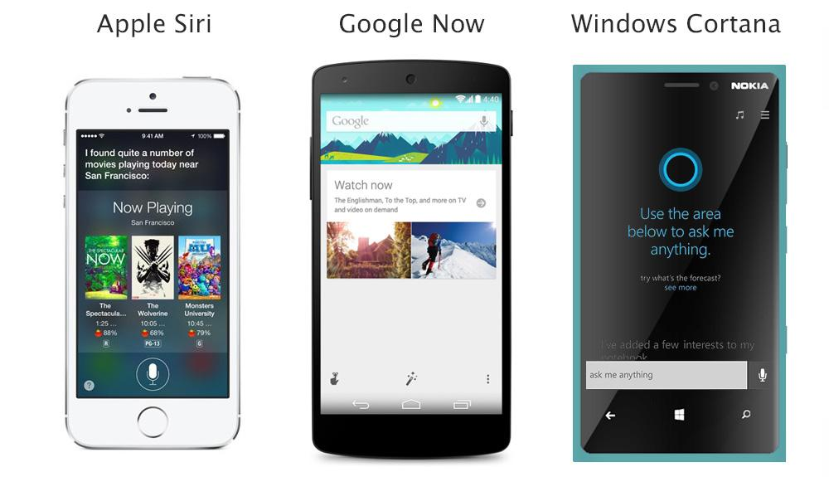
Famous Tech Based on Chatbots?

Slide 17
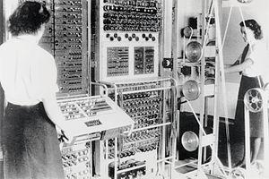
Who Programmed the Bombe?
Jean Valentine
Along with many others
Colossus machines
Call “Wrens”
Worked in parallel with the bombe
Woman programmed them
Considered “unskilled labor”
To the point of morning revelry
Mostly lost to history due to security restrictions
Many were not allowed to continue in computing.
Cryptographers were men, programmers were women
See page for author [Public domain], via Wikimedia Commons

Slide 18
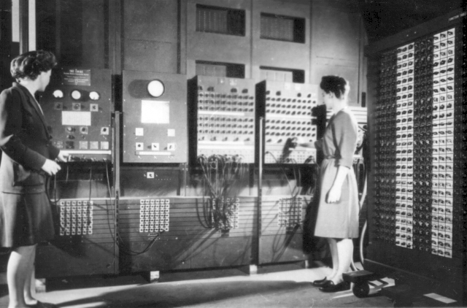
World War II - USA
Electronic Numerical Integrator and Computer (ENIAC)
The ‘silent’ programmers
Jean Jennings (Bartik)
Betty Snyder (Holberton)
Frances Bilas (Spence)
Kay McNulty (Mauchly Antonelli)
Marlyn Wescoff (Meltzer)
Ruth Lichterman (Teitelbaum).
Was considered “unskilled” labor
degrees in mathematics.
After the war?
They continued on after, had more, but limited freedom.
Defined the field
Changed the world
Programmers Betty Jean Jennings (left) and Fran Bilas (right) operate ENIAC's main control panel
By United States Army (Image from http://ftp.arl.army.mil/~mike/comphist/) [Public domain], via Wikimedia Commons

Slide 19
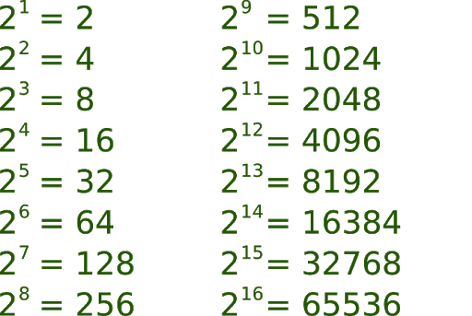
Base 10, Binary, Hex… Oh My!
Let’s Convert!

Slide 20
Example 137 => Binary => Hex

